Slide 1

World’s Population
Yuval Abargil
Tamir Baruch
Omri Asher

Slide 2
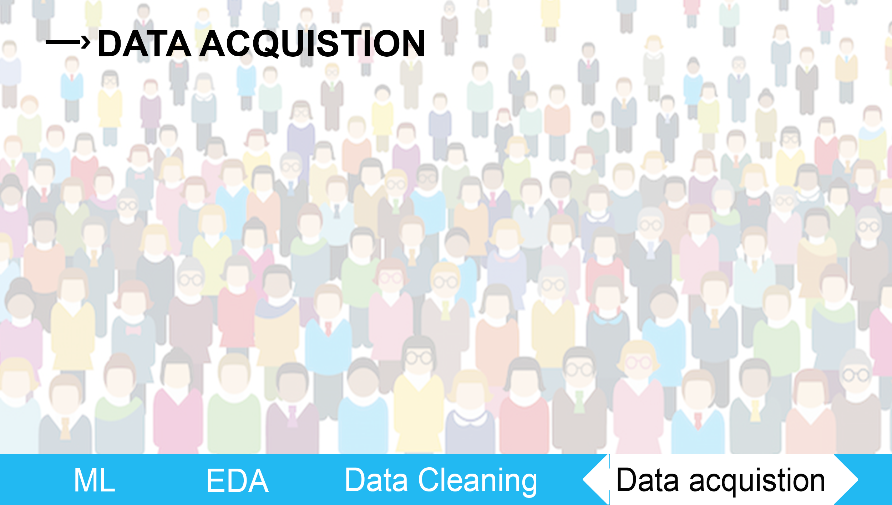

Slide 3

Data Acquisition
Data Sources:
Link 1: https://countryeconomy.com/hdi
Link2 : https://globaldatalab.org/

Slide 4
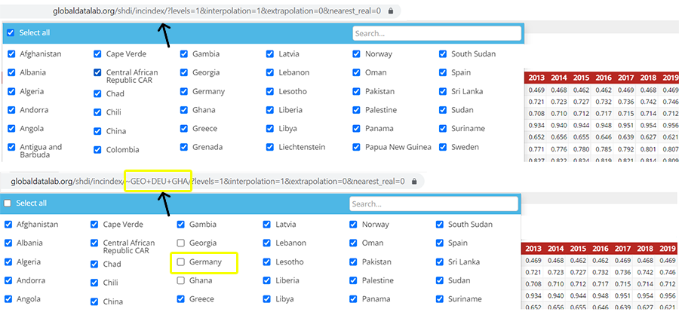
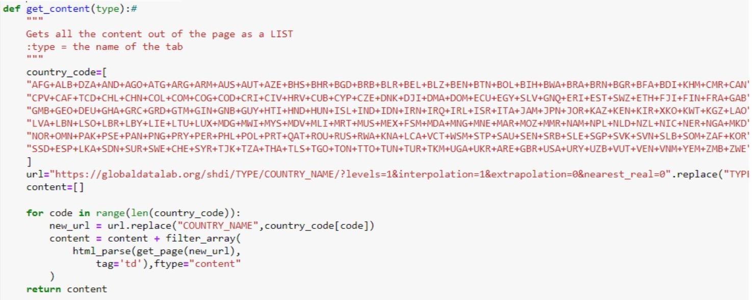
#Global Data Lab
The page from which we withdrew information had a ‘Show all’ button which blocked us from viewing the entire data ,As we retrieve the data we discovered that we only received 10 countries .As we explored the page a little bit further we noticed a certain pattern in the address bar that was hidden from us (illustration image) .We saw that it would be possible to generate the URL ourselves and to crawl the entire page by the help of get_content function as we wanted.

Slide 5
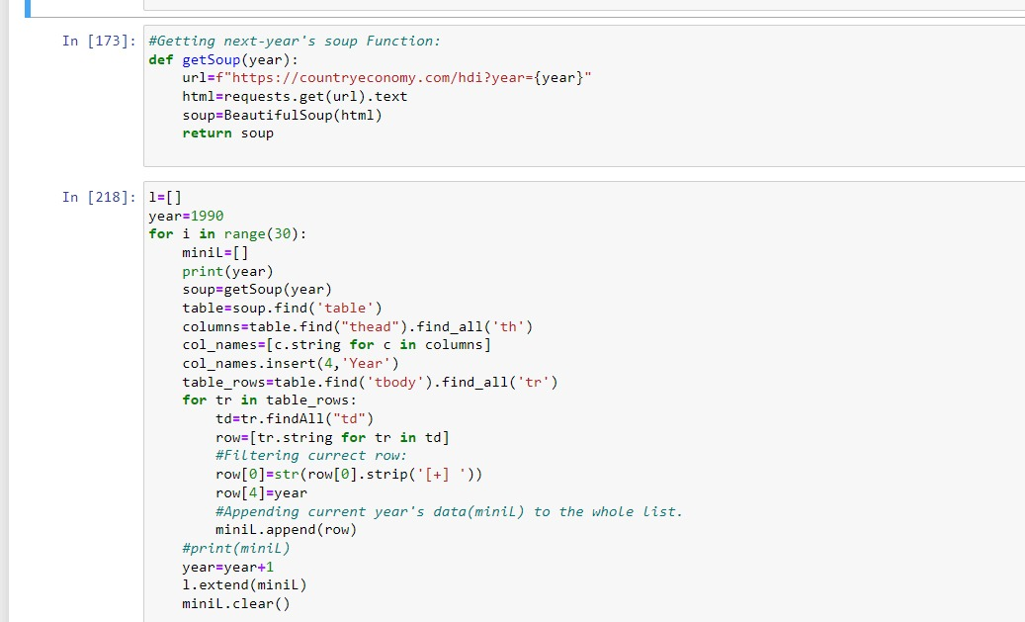
#Country Economy
By using pandas and BeautifulSoup we managed to withdrawn the relevant data from the specific page ,And with the addition help of a next page function we managed to crawl the entire site and obtaining our relevant data which was filtered to latest years(90’-19’).

Slide 6
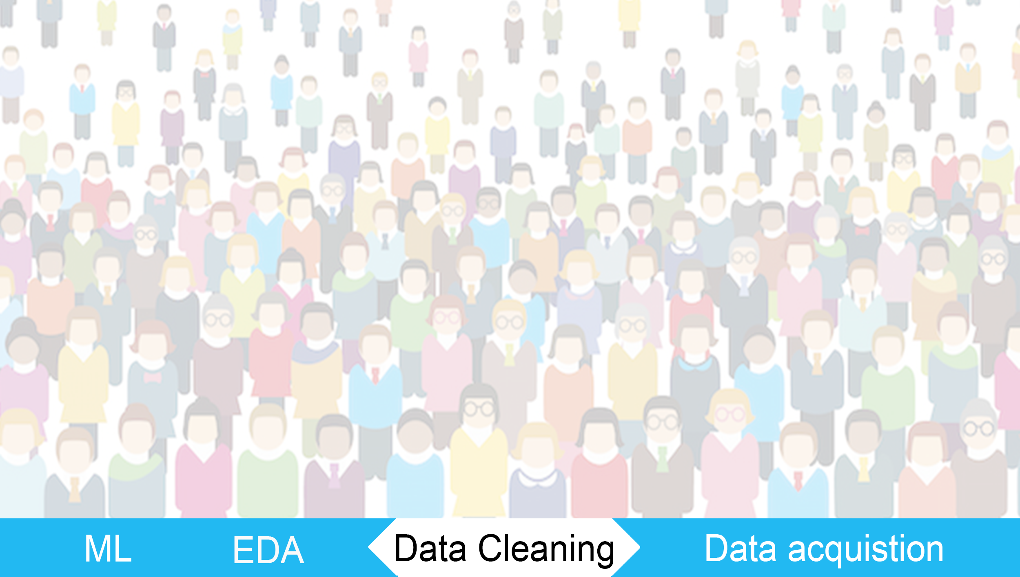

Slide 7

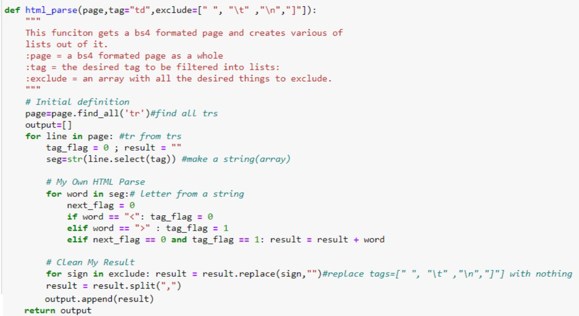
Data Cleaning –Merging The Data
By the help of html_parse function we were able to clean the unwanted characters (spaces, slashes, line descents, etc. * detailed in the pictures) and merge the data properly.

Slide 8
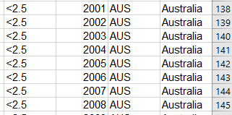
Data Cleaning –Merging The Data
As we scraped and crawled various number of sites , We’ve dealt with a merging problem :
*Different sites contains different countries
*Some sites were lacking information about the 90’s .
Values contains a large number (such as Chinas’ population)
Unmatching country strings such as Degree next to the # of rank and view more button which was part of the country string
Some of the taken data wasn’t presented as precise number ,We had to convert them to float to match our dataset and ignore the symbols (less than, greater than)

Slide 9

Data Cleaning – Filtering Data
By retrieving the data from different sources (almost each column was required different source ) we expected missing values
Our Data contains 167 different countries , As we collected data we knew each data will have different list of countries
Countries that had large amount of missing values were incapable to work with and were removed from the data

Slide 10
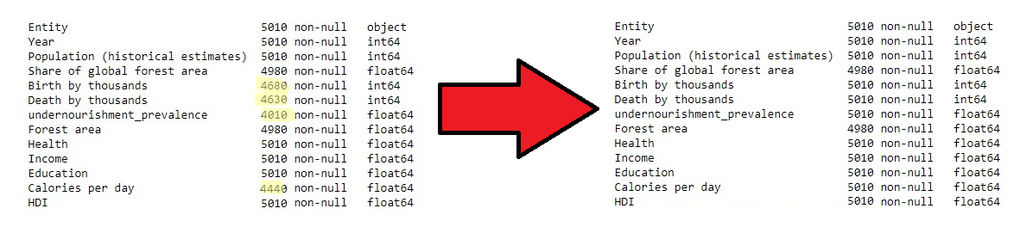
Data Cleaning – Results
After data was merged, We've checked the df’s shape and how many data were missing .
By replacing missing values with median of current countries we managed to gain a complete table without any missing values.

Slide 11
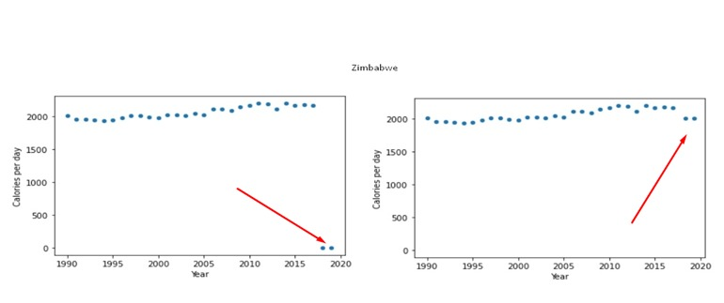
Data Cleaning – Outliners
By looking into depth we noticed some values we’ve taken are incorrect ,
Instead of removing them we handled them by updating their values into current country’s median.

Slide 12
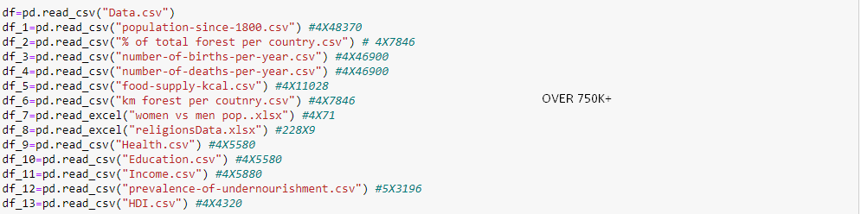
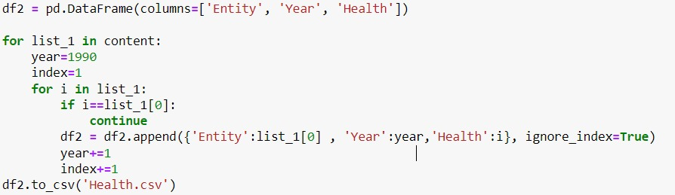
Data Cleaning - Numbers
As we finished obtaining our data we’ve reached a total number of 750K+ data ,
By using our filters we’ve managed to merge 13 different tables into one large csv file filtered to about 65K .

Slide 13
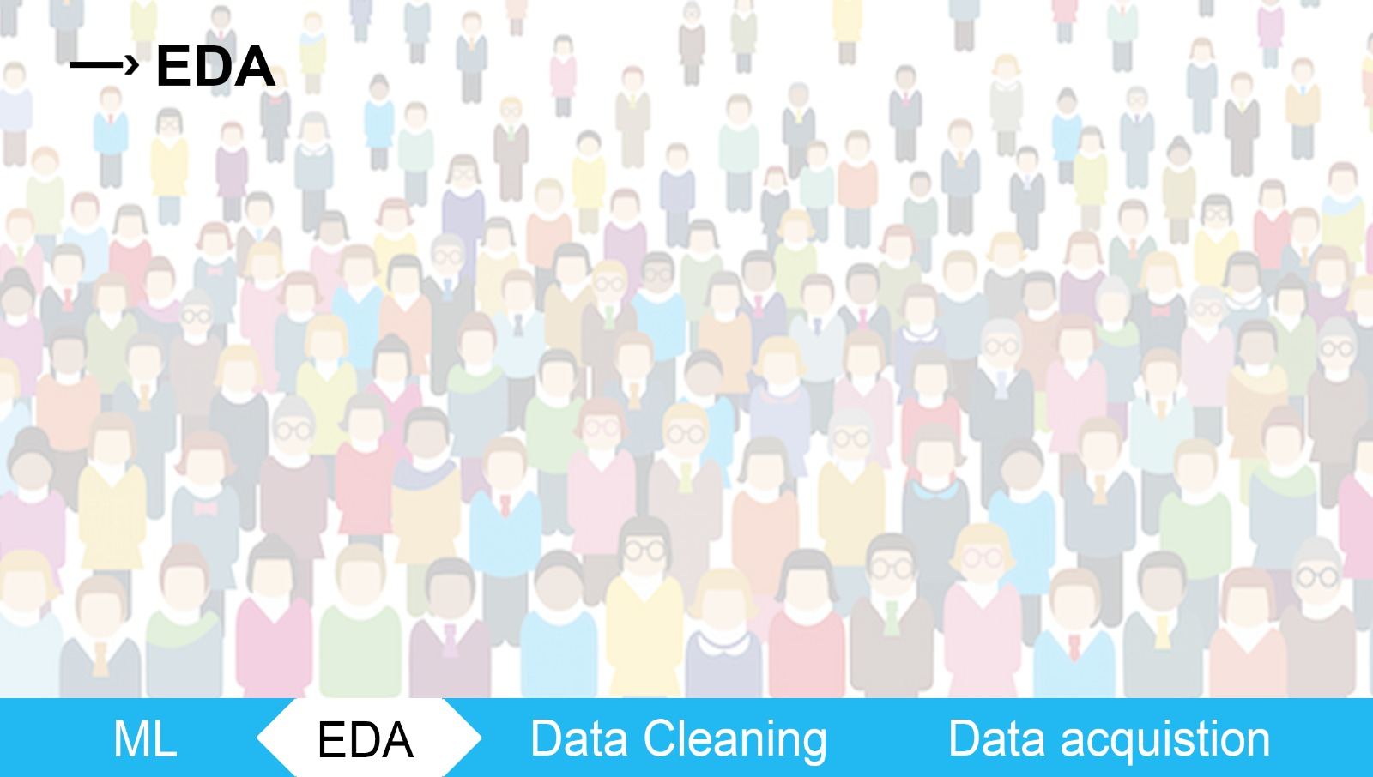

Slide 14
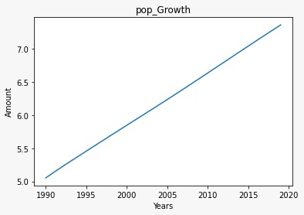
EDA - Population Growth
Name
A graph that describes world’s population growth
What does the graph contains ?
X-axis the years 1990-2020
Y-axis the amount of people(by billions)
Conclusion
We can see a solid increasement in population growth throughout the years.

Slide 15
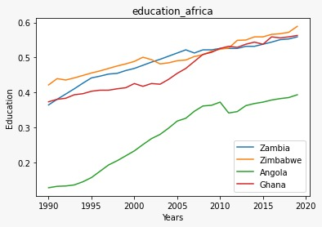
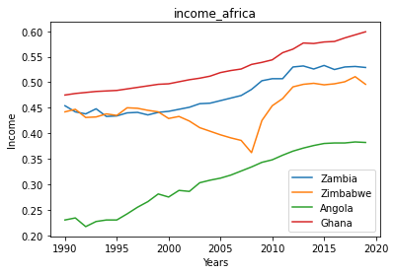
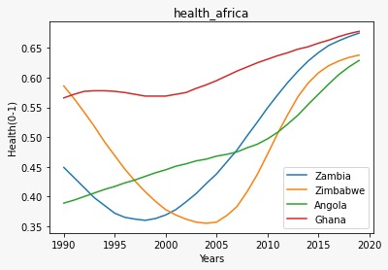
EDA- Africa’s living conditions
Name
A graph that describes living conditions of 4 countries in Africa (values between 0 -1)
What does the graph contains ?
X-axis the years 1990-2020
Y-axis health, income or education index
Conclusion
As seen on charts not all graphs contains a steady increasement in terms – we will explore it further

Slide 16
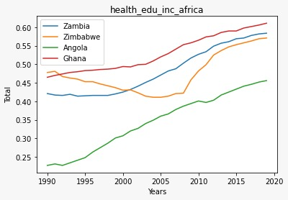
EDA- Africa’s living conditions
By merging the 3 indexes into one value we can now see clearly – there’s an improvement in living conditions . Our assumption is there is a clear connection between life conditions and population growth.

Slide 17
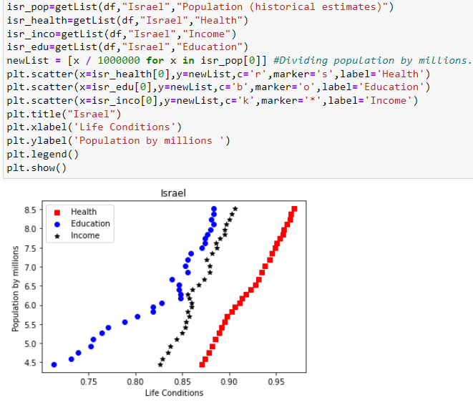
EDA- Africa’s living conditions
We’ve took Israel as an example for this graph. The graph shows us the direct effect life conditions has on how the population growth – The greater the life conditions the bigger the growth.

Slide 18
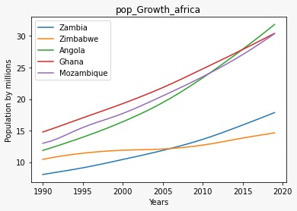
EDA-Africa’s Population Growth
Name
A graph that describes population growth of 4 countries
What does the graph contains ?
X-axis the years 1990-2020
Y-axis the amount of people(by millions)
Conclusion
We can see at most of the countries given In the graph a large yet similar increasement throughout the years – higher terms in life quality leads to population growth.

Slide 19
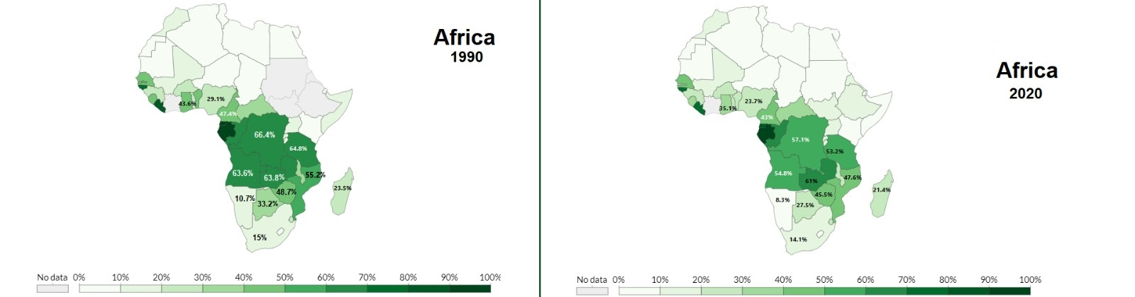
EDA –Africa’s Forests
Name
Forest degradation in Africa back then Vs. 2020
What does the photo contains ?
The percentage of the country covered by forests
a sketch that contains indicator of the colors in the map (Greener – high percentage , Whiter-lower percentage)
Conclusion
As seen in the map there’s a large degradation in Africa’s forest area, Back in 1990 as the population was smaller than today
there was a bigger forest area – The bigger the population increasement the higher the forest’s degradation.

Slide 20
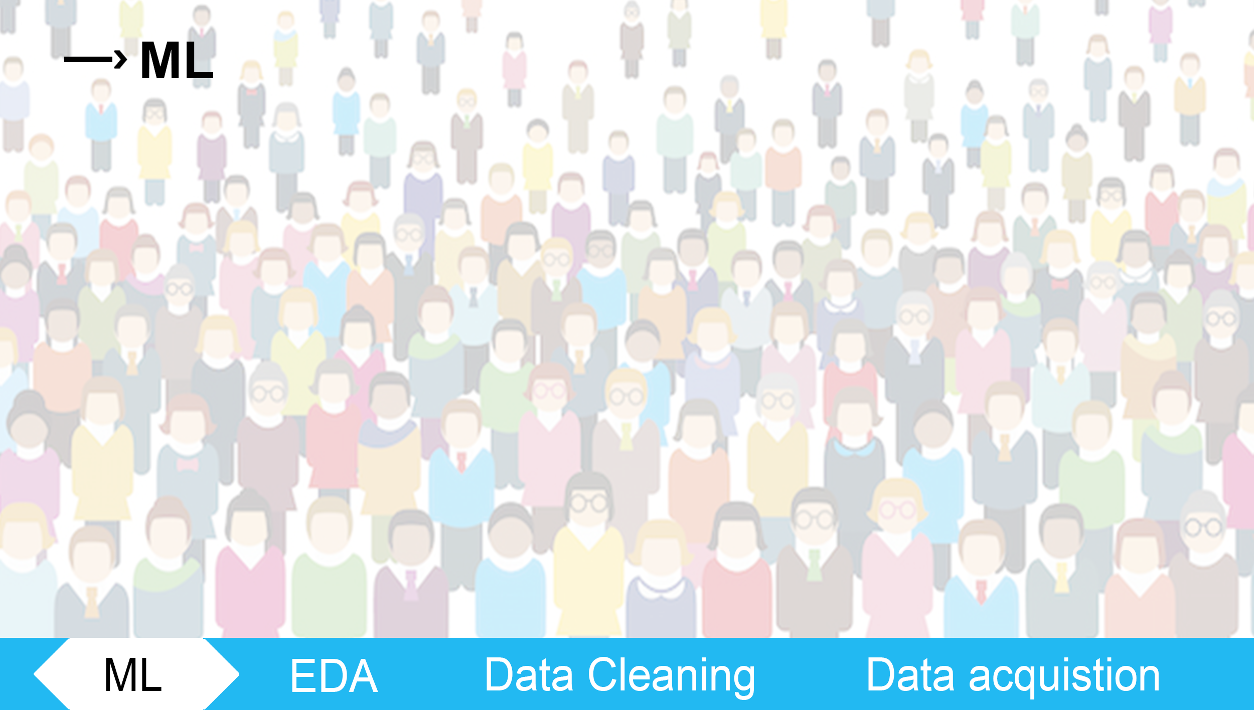

Slide 21
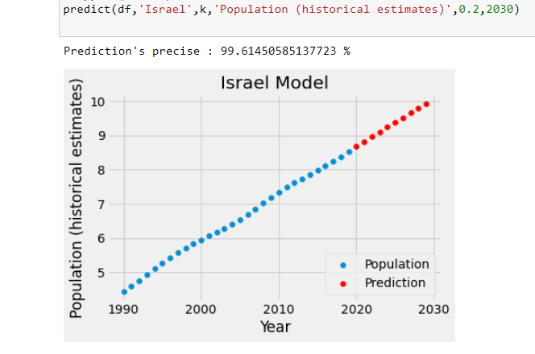
Machine Learning - Population
By using `sklearn` library and linear regression we were able to sum it all into a single function which takes country and train and test the model and then print a scatterplot on which we can see the next year’s prediction.
As we checked the precision of the model we reached 97~99% accuracy .

Slide 22
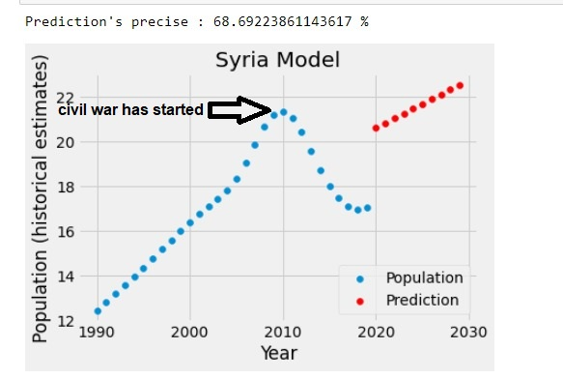
Machine learning – Unmatching model
As we tested more and more countries we noticed some countries were not reliable to our model , We checked those countries and noticed that even though their life conditions( such as income ,health etc.) were increasing ,their population did not growth and we took Syria as an example , Syria life conditions were increasing throughout most of the years so we checked why.
On Syria as we see on the chart the civil war begun at 2011 and since then the population decreased which doesn’t match our model (we didn’t considered wars) . Other countries that did not match out model had an epidemics or war, or a two-child policy.

Slide 23
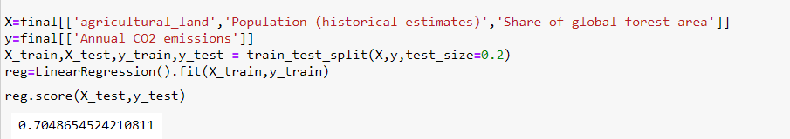
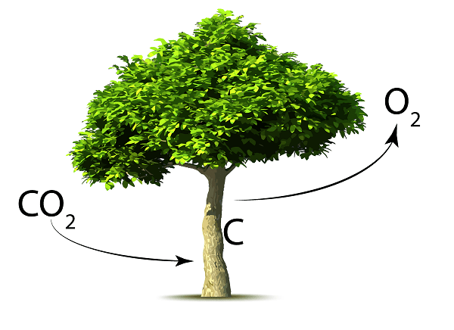
Machine learning – CO2 increase
We tried to build a model that will observe whether there is a relationship between the amount of population, the level of the Co2 (which is a factor that causes global warming leading to fires, etc.), and the agriculture areas on the global percentage of global forests. The model showed that there is a 40% relationship between these characteristics, we tried to improve the model as much as possible but without success (Which could happen due to lack of connection between the data or not enough of data to have a solid conclusion) and at the same time we noticed that there is a relationship between other characteristics (which we will represent soon) and decided to change our (second) research question - Is there a connection between the population growth, agriculture areas, and global forest decrease on the global Co2 level. We came to the conclusion that there is a 70% connection between them
Using sklearn library and linear regression we were able to analyze if the relationship between the data we gathered, are indeed affected by each other

Slide 24
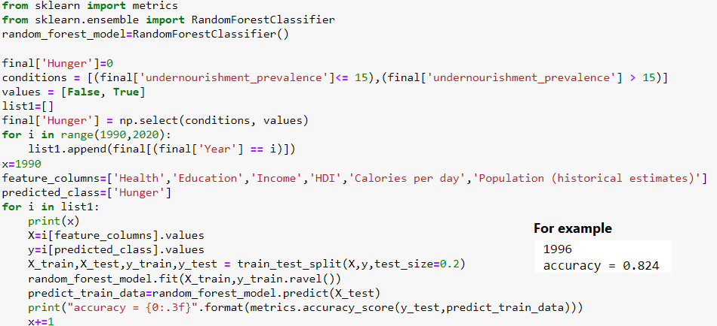

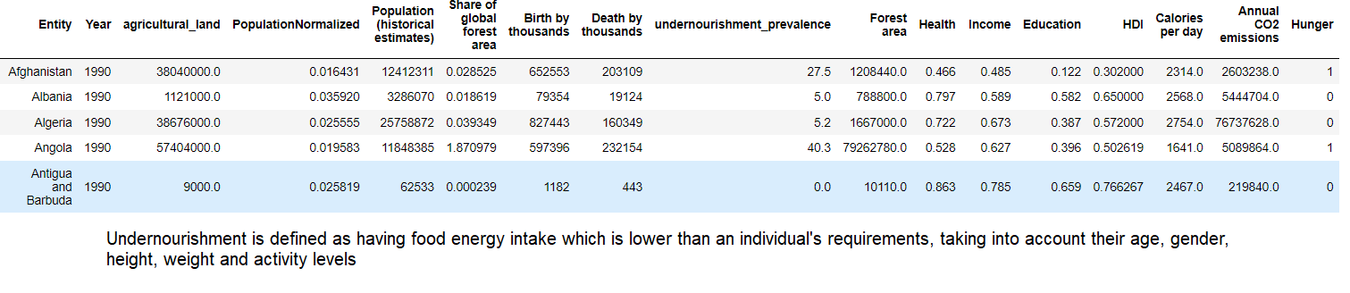
Machine Learning – Severe Hunger
In our third question we used a machine learning problem of classification, for this we had to use the random tree model . We learned about it online to see if given certain factors it would be possible to know if the country is starving severely. We created a new column in our dataframe representing Boolean values when nutrition category Is over 15% (which is explained below), We decided to test the model per year in order to give a more reliable forecast and came to the conclusion that there is a relationship of over 80% and we can predict fairly closely whether a country is likely to be in severe famine.

